Slide 1
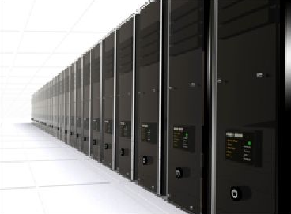
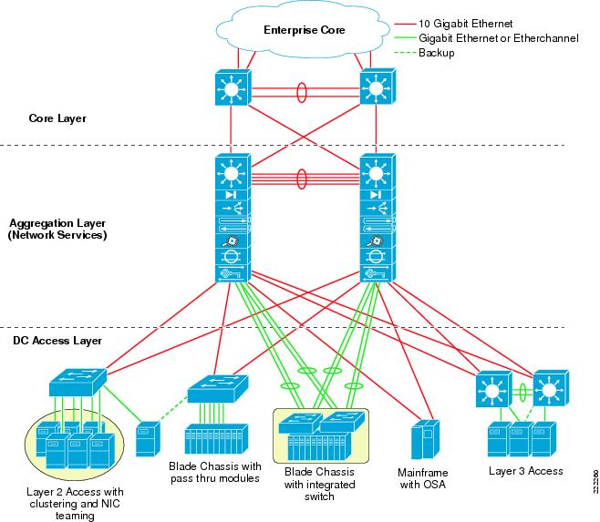
Simulating DataCenter Network Topologies
Suraj Ketan Samal
Upasana Nayak
1

Slide 2
Agenda
Data Center Networks (DCN)
Project Proposal (Our Work)
Network Topologies & Properties
Simulation using NS-3
Conclusion and Future Work
2

Slide 3
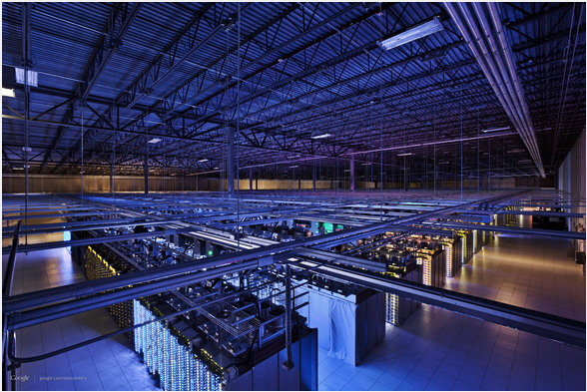
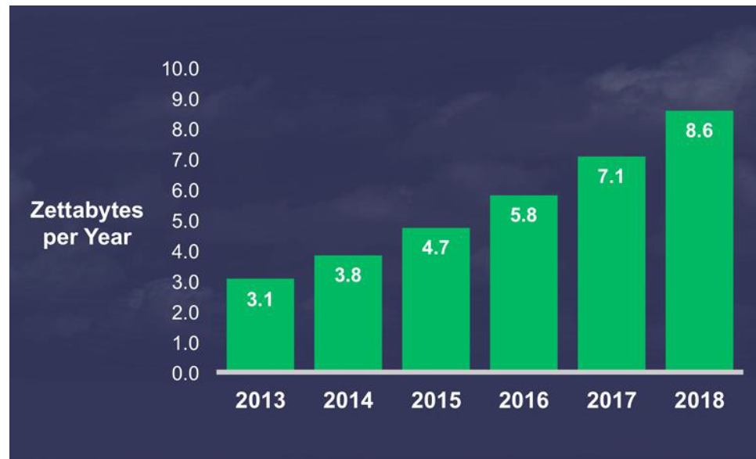
Data Center Networks(DCN)
A pool of interconnected resources that serve the internet.
Recent years have seen huge growth in data transfer especially due to multimedia, big-data and high speed internet.
Projected growth is ~23% per year
Managing data is inevitable and extremely challenging.
A Google Data Center
Courtesy : http://www.cse.wustl.edu/~jain/cse570-13/ftp/m_03dct.pdf
Cisco Global Cloud Index, 2013-2018
3

Slide 4
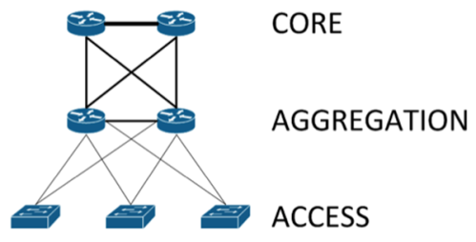

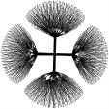
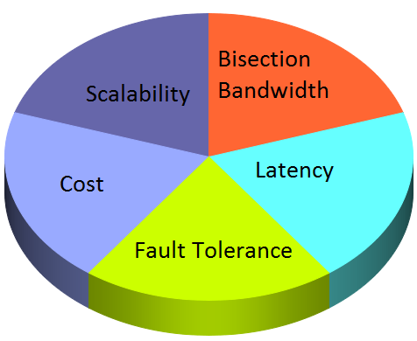


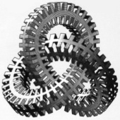
DCN – Overview & Challenges
Usually consists of three layers – core, aggregation and access
Nodes are connected using a interconnection network topology like FatTree, Flattened Butterfly or DCell
Topology is an important factor responsible for the challenges
Important Challenges
4

Slide 5
Project Proposal (Our Work)
Study and evaluate existing data center topologies (FatTree, Flattened Butterfly, BCube, Dcell, FiConn and HyScale).
Simulate on ns-3 tool under various traffic scenarios.
Design and simulation of a new-topology.
5

Slide 6
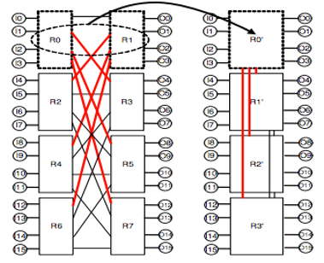
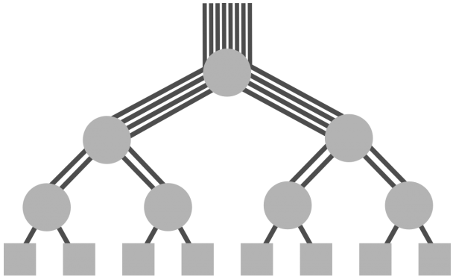
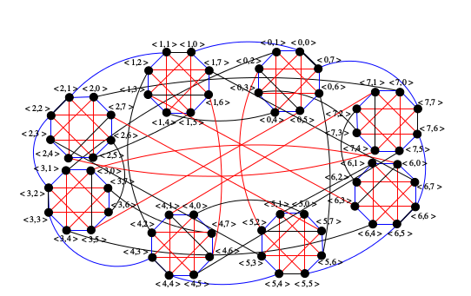
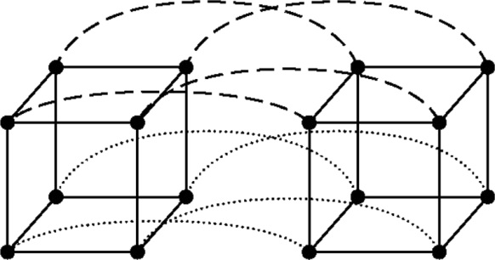
Important Topologies
FatTree
Flattened ButterFly
BCube
HyScale
6

Slide 7
Topologies – Important Properties
Topology | Servers | Diameter
FatTree | /4 (n= number of groups/pods) | k+1
BCube | (n = number of servers connected in basic unit, k= recursion depth) | 4
HyScale | (a = number of servers connected at each node, k= recursion depth, T = number of nodes in base model) | 4k+2
7

Slide 8
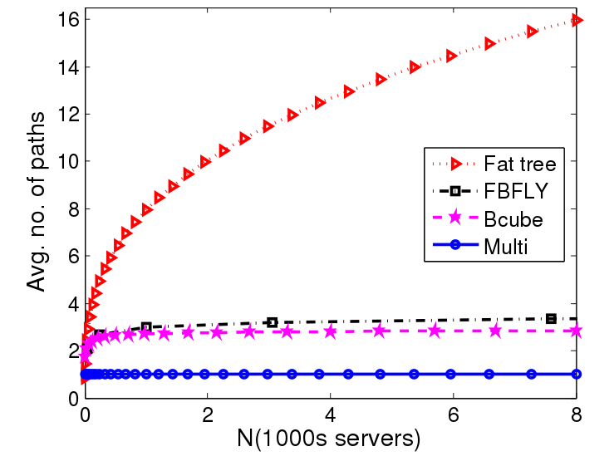
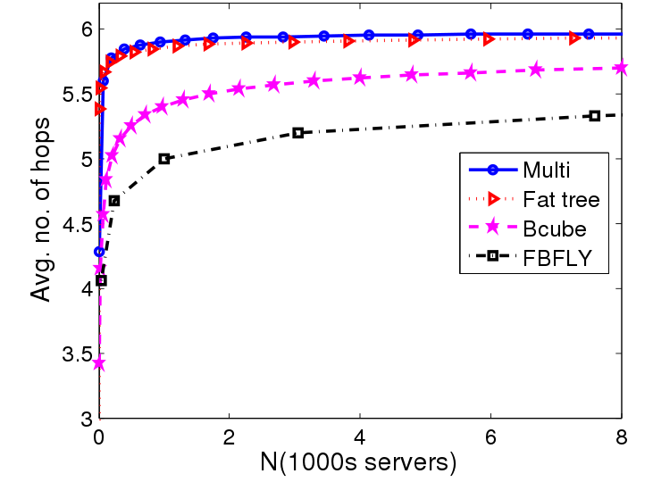
Topologies – A Comparision
FatTree
Flattened ButterFly
Average disjoint paths
Average Hop Count
8

Slide 9

Ns-3 : Network Simulator
Simulation tool that supports scripts in C++ or python.
Uses Netanim as a visualizer, but other tools can be used as well
Direct support for pcap trace files, xml outputs and plotting (gnuplot)
Conceptual design still the same as ns-2, but capability less that ns-2
9

Slide 10
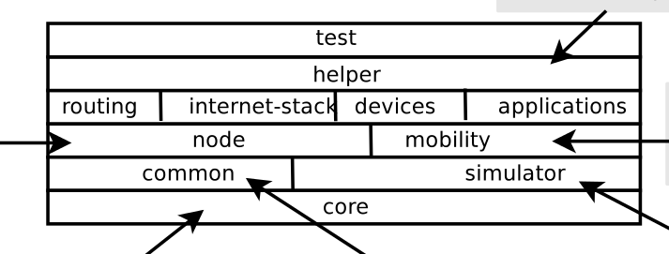
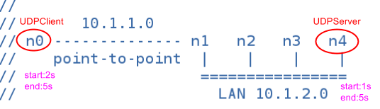
Ns-3: Architecture and an Example
ns-3 Architecture
An Example Topology
10

Slide 11
DCN Simulation Setup
Simulation Parameters | Fat-Tree | BCube | HyScale
Simulation Time | 100sec | 100sec | 100sec
PacketSize | 1024bytes | 1024bytes | 1024bytes
DataRates between switches | 1Mbps | 1Mbps | 1Mbps
DataRates between switches and hosts | 1000Mbps | 1000Mbps | 1000Mbps
Communication Pattern | Random selection of two hosts and sending data between them | Random selection of two hosts and sending data between them | Random selection of two hosts and sending data between them
Traffic Flow Pattern | Exponential Random | Exponential Random | Exponential Random
Routing Protocol | Nix-vector(ns-3) | Nix-vector(ns-3) | Nix-vector(ns-3)
Animator | NetAnim | NetAnim | NetAnim
Variable parameter(refer to Slide 7) | n varied (2-12) | k=2, n varied(2-12) | a=2, T=8, k varied from (1-3)
11

Slide 12
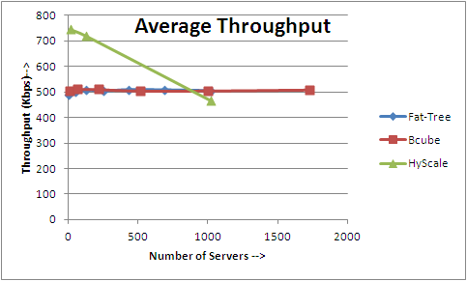
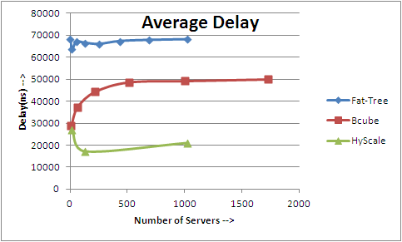
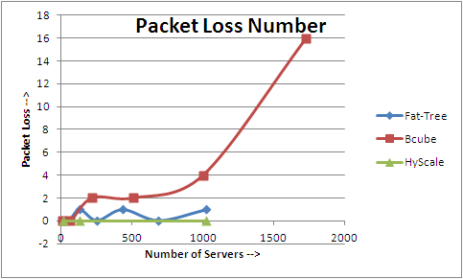
DCN Simulation: Results
Observed Average Throughput and Average Delay with exponential random traffic pattern.
Observed Packet loss with exponential random traffic pattern.
12

Slide 13
DCN Simulation: Observations
Simulated Fat-Tree and BCube topologies based on existing implementations.
Analysis and interpretation of results are still in progress.
Using ns-3 tool seemed complex since it's architecture has been designed to support simulation of new topologies and protocols.
13

Slide 14
Future Work
Complete simulations for other topologies (DCell, HyScale II and FiConn) and compare them.
Simulate topologies for other parameters (other types of traffic, fault-tolerance and bisection-bandwidth)
Extend ns-3 capabilities to support optical networks
14

Slide 15
References
[1] Cisco Global Cloud Index: Forecast and Methodology, 2013–2018. Retrieved from
https://www.cisco.com/c/en/us/solutions/collateral/service-provider/global-cloud-index-gci/Cloud_Index_White_Paper.pdf
[2] Bilal, Kashif, et al. "Quantitative comparisons of the state‐of‐the‐art data center architectures." Concurrency and Computation: Practice and Experience 25.12 (2013): 1771-1783.
[3] Bilal, Kashif, Samee Ullah Khan, and Albert Y. Zomaya. "Green Data Center Networks: Challenges and Opportunities." Frontiers of Information Technology (FIT), 2013 11th International Conference on. IEEE, 2013
[4] Saha, S., Deogun, J. S., & Xu, L. (2012, June). Hyscale: A hybrid optical network based scalable, switch-centric architecture for data centers. InCommunications (ICC), 2012 IEEE International Conference on (pp. 2934-2938). IEEE.
15

Slide 16
References
[5] D. Wong, K.T. Seow, C.H. Foh and R. Kanagavelu, “Towards Reproducible Performance Studies of Datacenter Network Architectures Using An Open-Source Simulation Approach”, Proceedings of the IEEE Global Communications Conference (GLOBECOM’13), December 2013, Atlanta, GA, USA.
[6] NS3-manual. At https://www.nsnam.org/docs/release/3.11/manual/ns-3-manual.pdf
[7] NS3-Tutorial. At https://www.nsnam.org/docs/release/3.22/tutorial/singlehtml/
[8] NTU-DSI-DCN Project. At http://ntu-dsi-dcn.github.io/ntu-dsi-dcn/
[9] Poor man’s tool to support Computer Networking. At www.netkit.org
16

Slide 17

Questions ?
17

